Slide 1
Digital Portfolio
STUDENT NAME:
REGISTER NO AND NMID:
DEPARTMENT:
COLLEGE: COLLEGE/ UNIVERSITY

Slide 2
PROJECT TITLE

Slide 3
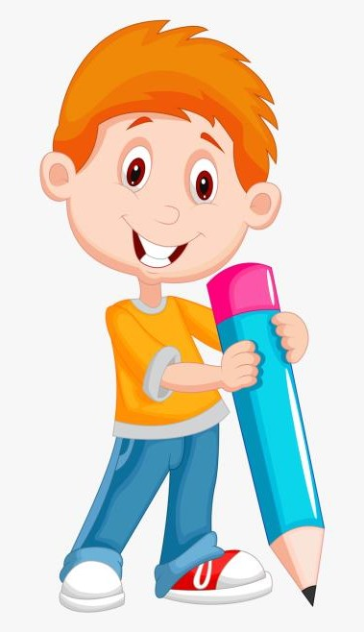

AGENDA
Problem Statement
Project Overview
End Users
Tools and Technologies
Portfolio design and Layout
Features and Functionality
Results and Screenshots
Conclusion
Github Link
3/21/2024 Annual Review

Slide 4

PROBLEM STATEMENT
In today’s digital world, users interact with content rapidly, often with minimal engagement. Traditional “like” buttons are less intuitive and require additional clicks, which reduces user interaction and emotional expression. There is a need for a simple, fast, and visually appealing way for users to show appreciation for content, especially on mobile platforms.The “Double Tap Heart” project addresses this problem by providing an intuitive double-tap gesture that instantly registers a like, represented by a heart animation, thereby enhancing user experience, engagement, and emotional connection with the platform.

Slide 5
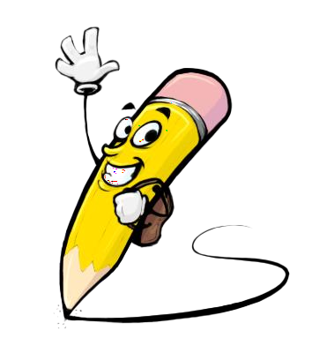
PROJECT OVERVIEW
The “Double Tap Heart” project is a user-interface feature designed to enhance engagement and interactivity on digital platforms. By enabling users to simply double-tap on content to express appreciation, the project focuses on making interactions more natural, seamless, and visually appealing.This project involves:Designing an intuitive gesture-based like system.Implementing heart animations for visual feedback.Ensuring cross-device compatibility for smooth performance.Enhancing overall user satisfaction and platform engagement.The goal is to create a simple yet impactful feature that can be integrated into applications, portfolios, or websites to increase user interaction and emotional

Slide 6

WHO ARE THE END USERS?
The “Double Tap Heart” feature is designed for a wide range of users who engage with digital platforms:Social Media Users – people who interact with posts, photos, and videos and want a quick way to show appreciation.Content Creators – individuals who benefit from increased engagement and instant feedback from their audience.Students & Developers – who can integrate this feature into their portfolios or projects to showcase creativity and interactivity.General Application Users – anyone using apps or websites that require an intuitive liking system for content.This ensures the feature is useful in both personal and professional contexts, boosting user satisfaction.

Slide 7

TOOLS AND TECHNIQUES
Design ToolsFigma / Adobe XD – for UI/UX design and layout creation.Canva – for simple graphics and mockups.Development Tools & TechnologiesHTML, CSS, JavaScript – for front-end structure, styling, and interactivity.React.js (or any frontend framework) – for creating responsive and dynamic UI.Animation Libraries (e.g., CSS animations, Framer Motion, GSAP) – for heart animation effects.Testing & DebuggingBrowser Dev Tools – for testing interactions across devices.Git/GitHub – for version control and collaboration.

Slide 8
POTFOLIO DESIGN AND LAYOUT
Home Page LayoutClean, minimal design with a focus on user-friendliness.Featured section to demonstrate the Double Tap Heart interaction.Project Showcase SectionDisplays the heart animation feature with screenshots and short descriptions.Organized in a grid/card layout for easy navigation.Design ElementsConsistent color scheme (red for heart animation, neutral background).Smooth typography hierarchy (titles bold, content simple).Rounded buttons/cards for a modern look.NavigationSimple menu for moving between Home, Projects, About, and Contact.Mobile-responsive layout for accessibility.User Experience FocusIntuitive interaction flow.Balance of visual appeal and functionality
8

Slide 9
FEATURES AND FUNCTIONALITY
Double Tap InteractionUsers can simply double-tap on content (image, card, or section) to “like” it.Heart AnimationA heart icon appears with animation (fade, pop, or pulse effect) to give instant visual feedback.Responsive DesignWorks smoothly on mobile, tablet, and desktop devices.Seamless User ExperienceQuick, intuitive, and requires no extra button click for liking.CustomizabilityHeart size, color, and animation speed can be modified based on project needs.Lightweight ImplementationBuilt with simple HTML, CSS, and JavaScript (or React) to ensure fast performance.Engagement BoosterEncourages more user interaction compared to traditional “like buttons.”

Slide 10

RESULTS AND SCREENSHOTS
ResultsSuccessfully implemented a double-tap like feature with smooth heart animation.Improved user engagement by making interactions faster and more intuitive.Verified cross-device compatibility, ensuring responsiveness on mobile, tablet, and desktop.Demonstrated as part of a student portfolio project to showcase creativity and UI/UX skills.Screenshots (to be added)Example of content before double-tap.Example of content after double-tap with animated heart.Demo page/portfolio section showing the feature in action.
3/21/2024 Annual Review
10

Slide 11
CONCLUSION
The “Double Tap Heart” project successfully demonstrates how a simple gesture-based interaction can enhance user engagement and satisfaction.By combining creative design, animation, and functionality, the feature provides an intuitive and visually appealing way for users to express appreciation.The project highlights skills in UI/UX design, front-end development, and portfolio presentation.This feature can be further expanded and integrated into websites, mobile apps, and digital portfolios, proving its practicality and scalability.Overall, the project reflects a balance of innovation, creativity, and technical implementation suitable for student learning and real-world application.
11

